Slide 1
For the year ended 31 August 2021

Slide 2
Disclaimer
This presentation may contain certain "forward-looking statements" regarding beliefs or expectations of TWK Investments Limited (TWK), its directors and other members of its senior management about TWK’s financial condition, results of operations, cash flow, strategy and business and the transactions described in this presentation. Forward-looking statements include statements concerning plans, objectives, goals, strategies, future events or performance, and underlying assumptions and other statements, which are other than statements of historical facts. The words "believe", "expect", "anticipate", "intend", "estimate", "forecast", "project", "will", "may", "should" and similar expressions identify forward-looking statements but are not the exclusive means of identifying such statements. Such forward-looking statements are not a guarantee of future performance. Rather, they are based on current views and assumptions and involve known and unknown risks, uncertainties and other factors, many of which are outside the control of TWK and are difficult to predict, that may cause the actual results, performance, achievements or developments of TWK or the industry in which it operates to differ materially from any future results, performance, achievements or developments expressed by or implied from the forward-looking statements. Each member of TWK expressly disclaims any obligation or undertaking to provide or disseminate any updates or revisions to any forward-looking statements contained in this presentation.

Slide 3
Agenda
01
02
03
Results at a glance
Financial performance and segmental review
Outlook

Slide 4
RESULTS at a glance
01

Slide 5
2021 AT A GLANCE
For the YEAR ended 31 AUGUST 2021
Revenue
R8.9bn
up 15.3%
2020: R7.7bn
Operating profit
R491.0m
up 66.8%
2020 : R294.3m
Profit after tax
R257.2m
up 137.1%
2020 : R108.5m
Basic EPS
645 cents
up 100.9%
2020 : 321 cents
NAV per share
R46.36
up 8.2%
2020: R42.83
Cash from operating activities
R622.7m
up 0.6%
2020 : R619.1m

Slide 6
THE YEAR AT A GLANCE
TWK reported an excellent set of results for the year ended 31 August 2021, mainly due to:
an increased demand from the Company’s key timber markets;
excellent trading conditions;
increased volumes in the sale of fertilizer; and
the strategic acquisitions of:
the Peak Timbers’ assets; and
a 51% shareholding in Sunshine Seedlings Services
The diversity of TWK’s income streams continued to provide resilience amidst the tough trading conditions and macroeconomic challenges
The Group’s financial position is solid with strong cash generated
Gearing level increased as a result of the acquisition of Peak Timbers, still well within the target band

Slide 7
CORPORATE ACTIONS
Transaction | Description | Interest at 31 Aug 2021 | Comment
BedRock Mining | TWK acquired a further 10% interest | 100% | -
Sunshine Seedlings Services (Sunshine Seedlings) | Sunshine Seedlings is a large nursery business yielding some of the highest quality timber and vegetable seedlings in South Africa Sunshine Seedlings produces over: 50 million vegetable seedlings; 10 million forestry clones; 7 million forestry seedlings; and 4 million essential oil seedlings | 51% | Effective 1 September 2020 SSS contributed R27.9 million to EBITDA for the year under review Irrevocable right to acquire the remaining 49% interest over the next five years, at agreed terms and financial ratios
Peak Timbers | Acquisition of the forestry assets: 26, 752 ha of land; 20,000 ha of standing timber; buildings; and a sawmill operation for R577.1 million | 100% | Effective 11 March 2021 Peak Timbers contributed R18.5 million to EBITDA for the year under review
Delisted from ZARX Listed on Cape Town Stock Exchange (CTSE) Planned secondary listing on A2X | Decision to move listing was taken before ZARX was suspended First listing under the new CTSE name – refer to principal reasons on slide 7 |  | No liquidity Share price increased by 9% since listing on CTSE on 30 September 2021 On or about 30 November 2021

Slide 8
PRINCIPAL REASONS FOR LISTINGS
The principal reasons for the CTSE Listing (as a primary listing), coupled with a planned secondary listing on A2X, is to:
enhance the ability and liquidity to trade in TWK Shares;
position the Company strategically better to attract institutional investors, in the near future, due to open market access developments associated with CTSE and A2X;
promote the Company’s ability to raise capital and list equity and debt on a single primary exchange;
provide additional protection to TWK Shareholders having access to a CTSE client protection fund; and
have a primary listing and secondary listing on exchanges which the Board both regard as financially sustainable in the long-term
TWK FINAL results presentation 2021

Slide 9
Financial performance and segmental review
02

Slide 10
Key financial indicators
For the YEAR ended 31 AUGUST 2021
5-year CAGR 6.5%
5-year CAGR 10.9%
5-year CAGR 17.3%
5-year CAGR 9.0%

Slide 11
Key financial indicators (continued)
8.2%

Slide 12
SHARE STATISTICS
5-year CAGR 21.0%

Slide 13
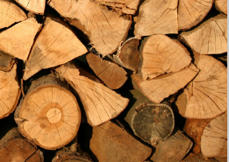
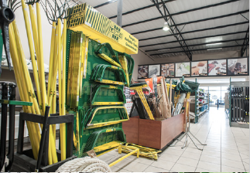
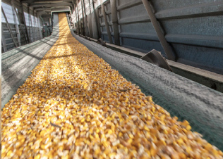
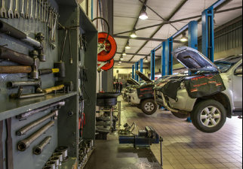
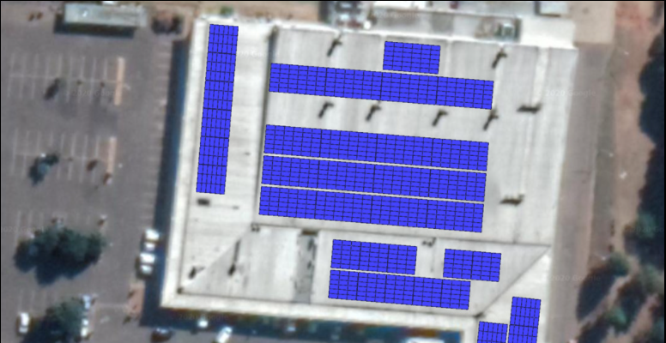
Segment analysis
Excluding corporate costs
TIMBER | RETAIL & MECHANISATION | GRAIN | FINANCIAL SERVICES | MOTORS & TYRES | RENEWABLE ENERGY
Revenue R1.9bn (FY21) R1.8bn (FY20) | Revenue R4.0bn (FY21) R3.4bn (FY20) | Revenue R1.8bn (FY21) R1.3bn (FY20) | Revenue R182.1m (FY21) R173.5m (FY20) | Revenue R1.1bn (FY21) R979.6m (FY20) | Revenue R3.4m (FY21) N/A (FY20)

Slide 14
TIMBER
Revenue increased by 2.3% primarily due to:
the better performance delivered by mining timber products;
timber sales from own plantations; and
the inclusion of the acquisitions concluded during the year
Revenue was supported by:
the increase in international demand for woodchips; and
higher mining timber sales volumes compared to the prior year
EBITDA increased by 119.7% as a result of the conditions mentioned under revenue
EBITDA margin increased from 6.8% (Aug 2020) to 14.7% on the back of the inclusion of Sunshine Seedlings

Slide 15
Retail and mechanisation
Revenue increased by 17.7% - the best results on record and far exceeded expectations
Constantia Fertilizer reported an exceptionally strong performance on the back of effective buying strategies and higher fertilizer volumes sold
22.6% increase to 283 362 tonnes (2020: 231 175 tonnes)
Mechanisation increased market share in tractor sales:
39% (Aug 2020: 36%) in KwaZulu-Natal; and
38% (Aug 2020: 32%) in Mpumalanga
Retail gross profit was boosted by 2.1% due to the Covid-relief vouchers given to farmers
Market share was gained from other Agri retailers
EBITDA increased by an impressive 151.2%
EBITDA margin also increased to 3.9% (2020: 1.8%)

Slide 16
GRAIN
Revenue increased by 33.7% supported by:
the higher grain prices despite:
Arrow Feeds, based in eSwatini, reporting a decrease of 3.8% in volumes; and
the Grain Storage business reporting a 2.8% decline in storage through-put due to low carry-over maize stock in SA and grain being transported from farms to end-users, thus bypassing the silo’s
the Grain Marketing business increasing their market share with additional tonnes marketed
EBITDA decreased by 6.0%
EBITDA margin declined to 2.7% (2020: 3.8%)
Margins came under pressure as a result of the high maize prices
The reimplementation of load shedding in SA also hindered the grain mill’s performance

Slide 17
FINANCIAL SERVICES
Revenue and EBITDA increased by 4.9% and 124.9%, respectively
The Insurance Division reported:
a 23% growth in short-term insurance premiums;
a 2.3% decrease in total crop insurance premium as a direct result of a 5% decrease in crop hectares insured; offset by
a 28.8% increase in total tree hectares insured
The Medical Insurance Portfolio continued to show remarkable growth - commission revenue grew by 76.7% as a result of an increase of 103% in members from 2,178 members (31 August 2020) to 4,423 members (31 August 2021)
The Credit Division reported growth of 48.9%, mainly due to higher grain plantings, higher input costs for farmers as well as increased market penetration
The Production Credit Book grew strongly by 24% to R543 million as at 28 February 2021 (29 February 2020: R438 million) - as at 31 August 2021, the Production Credit Book was R318 million (31 August 2020: R214 million) as farmers were able to settle their accounts as a result of benefitting from good crop yields and high grain prices

Slide 18
Motors and tyres
Revenue increased by 8.3% mainly due to:
increased vehicle sales due to the inclusion of a new dealership branch;
16.4% increase in new tyre sales volumes; and
1.3% increase in re-treaded truck tyre sales volumes
Dealerships delivered:
a 65.6% increase in new vehicle sales (incl new dealership branch); and
a 26.6% increase in used vehicle sales
Petrol and diesel sales volumes decreased by 22.6% from 15 252 380 litres (2020) to 11 807 441 litres
EBITDA decreased by 25.8% mainly as a result of the loss-making Filling Station division
EBITDA margin declined to 2.3% (2020: 3.3%)
A decision was taken to close loss-making businesses during the year
Sold Silo Panel Beaters

Slide 19
RENEWABLE ENERGY
TWK’s strategy is to invest in renewable energy
Roofspace Rental Group (Roofspace), registered in South Africa and eSwatini, is an energy savings initiatives company that endeavours to reduce the electricity supply risk to its corporate clients by providing solar energy
Signed lease contracts with four malls during the year
Approved the lease agreements for nine additional malls
Roofspace has also entered into sole supplier agreements with two large property retailers
From an environmental perspective, the 11,4 Megawatts of Solar Projects at the initial 13 shopping centres will offset approximately 19 000 tons of carbon emissions (CO2e) per annum in the first year of operation
EBITDA margin is 19.7%

Slide 20
Outlook
03

Slide 21
OUTLOOK
TWK remains optimistic about the outlook for agriculture in South Africa
The view of management is that the financial year ending 31 August 2022, should market conditions remain stable or improve, should outperform the 2021-year’s results
TWK remains well positioned for growth, with a focus on projects across all segments with expansions, acquisitions, mergers and strategic alliances
We will continue our efforts to optimise existing offerings
Strategic outcomes are evaluated annually
TWK remains focused on delivering the Company’s strategic intent of growing profitability

Slide 22
Thank you
For any further Investor Relations questions please contact:
Keyter Rech Investor Solutions
Marlize Keyter
mkeyter@kris.co.za
+27 (0)87 351 3810
André Myburgh
Managing Director
Eddie Fivaz
Financial Director
Switchboard: +27 (0)17 824 1000 www.twkagri.com

Slide 23
Background on twk
On 21 June 1940 the Transvaal Wattle Growers Co-operative Agricultural Company Ltd was registered
On 1 September 2014 the company was restructured into its current form with TWK Agriculture Holdings (Pty) Ltd as the ultimate holding company and TWK Investments Ltd as the investment and listed entity
TWK Investments Ltd (TWK) listed on the ZAR X stock exchange on 12 June 2017 at a share price of R12.35 – market capitalisation of R433 million
TWK listed on the Cape Town Stock Exchange (CTSE) on 30 September 2021, at R35.00 per share, with a planned secondary listing on the A2X Stock Exchange on or about 30 November 2021
Employees at 31 August 2021 – 3 104
Market capitalisation as at 24 November 2021 – R1.6 billion

Slide 24
STRATEGY

